Slide 1
Section 1.1 Understanding Data With Box Plots
© Copyright all rights reserved to Homework depot: www.BCMath.ca

Slide 2
What is a Box Plot?
A BoxPlot is used show where your data plots are allocated
The left end tells you the lowest value in your data
The middle bar indicates the “median” of your data.
The right end tells you the biggest value in your data
The middle bar isn’t going to be in the middle on the box plot!
The 2nd bar indicates the 25% mark: Q1. It means that 25% of the data is less than this point
The 4th bar also indicates the 25% mark. Q3. It tells us that 25% of the data points are greater than this point
Suppose you had pages of data, looking through all these numbers would be difficult. One way to analyze your data is to find the max, min, middle value, and where most values are in:
NOW Create the BOX!!
This box between Q1 and Q3 shows the middle 50% of all the data is inside here
12 14 67 19 12 14 67 19 12 14 67 19 12 14 67 19 12 14 67 19 12 14 67 19 12 14 67 19 12 14 67 19 12 14 67 19 12 14 67 19 12 14 67 19 12 14 67 19 12 14 67 19 12 14 67 19 12 14 67 19 12 14 67 19 12 14 67 19 12 14 67 19 12 14 67 19 12 14 67 19 12 14 67 19 12 14 67 19 12 14 67 19 12 14 67 19 12 14 67 19 12 14 67 19 12 14 67 19 12 14 67 19 12 14 67 19 12 14 67 19
NOW Draw the WHISKERS!
12 14 67 19 12 14 67 19 12 14 67 19 12 14 67 19 12 14 67 19 12 14 67 19 12 14 67 19 12 14 67 19 12 14 67 19 12 14 67 19 12 14 67 19 12 14 67 19 12 14 67 19 12 14 67 19 12 14 67 19 12 14 67 19 12 14 67 19 12 14 67 19 12 14 67 19 12 14 67 19 12 14 67 19 12 14 67 19 12 14 67 19 12 14 67 19 12 14 67 19 12 14 67 19 12 14 67 19 12 14 67 19 12 14 67 19 12 14 67 19
12 14 67 19 12 14 67 19 12 14 67 19 12 14 67 19 12 14 67 19 12 14 67 19 12 14 67 19 12 14 67 19 12 14 67 19 12 14 67 19 12 14 67 19 12 14 67 19 12 14 67 19 12 14 67 19 12 14 67 19 12 14 67 19 12 14 67 19 12 14 67 19 12 14 67 19 12 14 67 19 12 14 67 19 12 14 67 19 12 14 67 19 12 14 67 19 12 14 67 19 12 14 67 19 12 14 67 19 12 14 67 19 12 14 67 19 12 14 67 19
12 14 67 19 12 14 67 19 12 14 67 19 12 14 67 19 12 14 67 19 12 14 67 19 12 14 67 19 12 14 67 19 12 14 67 19 12 14 67 19 12 14 67 19 12 14 67 19 12 14 67 19 12 14 67 19 12 14 67 19 12 14 67 19 12 14 67 19 12 14 67 19 12 14 67 19 12 14 67 19 12 14 67 19 12 14 67 19 12 14 67 19 12 14 67 19 12 14 67 19 12 14 67 19 12 14 67 19 12 14 67 19 12 14 67 19 12 14 67 19
Each Whisker represents 25% of the data points

Slide 3
Practice: Suppose the boxplot below are scores from last years AP Stats class, use the boxplot to answer the following questions:
a) What is the maximum score in the class?
b) What is the minimum score in the class?
c) What percentage of the class got a score less than 86%?
d) What is the range in score for the bottom 25% of the class?
e) Half of the class got higher than what score?

Slide 4
II) BOXplots: IQR and Five number Summaries
When asked to give the 5 Number Summary, these are values you need:
1. Minimum: The lowest number, lowest data point
2. Q₁: First Quartile, the 25% mark, 25% of data points are less than Q1
3. Median: the middle term, (if two terms are in the middle, take the average of the two)
4. Q₃ : third quartile,, the 75% mark, 25% of data points are greater than Q3
5. Maximum: The highest number
Interquartile Range (IQR): the distance between the Q1 and Q3 (IQR = Q3 – Q1)
“Outliers”: Data points that are greater than Q3 by (1.5IQR) or less than Q1 by (1.5IQR)
Outliers are data points that differ significantly from other observations. You indicate outliers in a boxplot by using a separate point or star
If less than 1.5xIQR from Q1
If greater than 1.5xIQR from Q3
IQR
Outlier
Outlier
Min
Q1
Median
Q3
Max

Slide 5
Finding Q1 and Q3 and Outliers
Suppose you have 9 data points in ascending order: “A, B, C, D, E, F, G, H, I”
Use your Ti 83 to find the 5 Quarter number summary. Don’t calculate by hand! Just use a 1-variable statistical calculation!
Which letter would represent the median?
E
Which letter would represent the Q1?
Finding Outliers
Which letter would represent the Q3?
First find the inerquartile range (IQR)
Multiply the IQR by 1.5
Any values less than Q1 minus 1.5xIQR is an outlier
Any value greater than Q3 plus 1.5x IQR is an outlier
Suppose you have 10 data points in ascending order: “A, B, C, D, E, F, G, H, I, J ”
Which letters would represent the median?
Which letter would represent the Q1?
Which letter would represent the Q3?

Slide 6
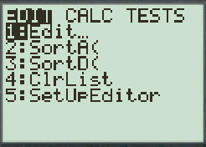
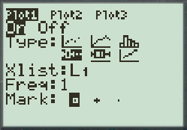
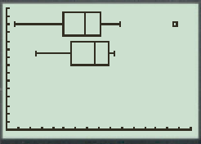
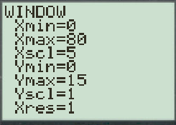
Drawing Boxplots with Ti-83
Enter data in L₁
Press “Stats” and “Edit”
Enter your data under L₁
Choose your graph
Press “2nd” and “Y=”
Press “Enter” and choose Plot 1
Two Boxplot options
Left: Excludes Outliers
Right: Include Outliers
Set the “Window”
Press “Window”
Set “Xmin” and “Xmax” according to the data set
Press “Enter”

Slide 7
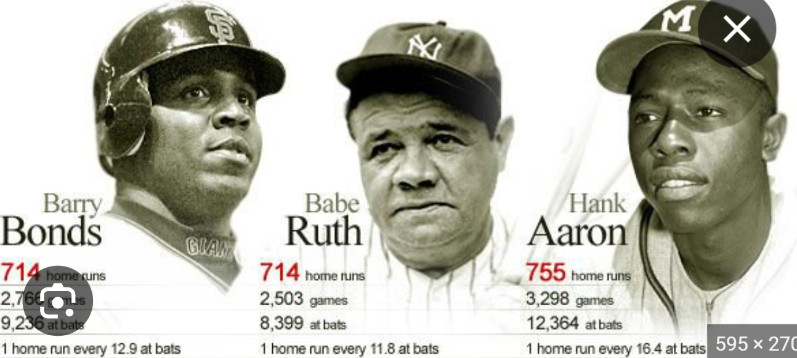
Who was the greatest homerun hitter of all time?

Slide 8
Ex: The following data on home runs hit per season for Barry Bonds and Hank Aaron over the course of their careers. Bonds – 16 25 24 19 3 25 34 46 37 33 42 40 37 34 49 73
Aaron – 13 27 26 44 30 39 40 34 45 44 24 32 44 39 29 44 38 47 34 40 20
a) Find the 5 number Summaries, IQR, Outliers for each person
b) Make a box plot for each data and draw comparisons
c) Who is better at hitting homeruns? Justify your answer
a) 5 Number Summary for Bonds: Min: 3, Q1: 24.5, Med:34, Q3: 41 and Max: 73
IQR = 41 – 24.5 = 16.5 1.5IQR = 24.75 Q3+24.75 = 65.75
The season with 73 homeruns for Bonds is an Outlier season. The season with 3 homeruns for Bonds is NOT an Outlier season
5 Number Summary for Aaron: Min: 13, Q1: 28, Med:38, Q3: 44 and Max: 47
IQR = 44 – 28 = 16 1.5xIQR = 24 Aaron does not have any outlier seasons

Slide 9
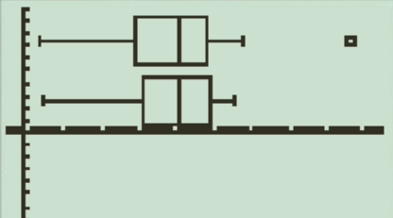
To make a boxplot for each data set, go to “Scatterplot”
The boxplot on top represents the number of homeruns BONDS have in each season and the boxplot on the bottom represents the number homeruns Aarons have in each season.
Observation: From our observation, Aaron has a higher Q1, Median, Q3, and minimum than Bonds. Q1: 28 vs 24.5, Median: 38 vs 34 Q3: 44 vs 41. The minimum the number of H Runs in a season is also higher for Aaron.
From our boxplot we can observe that the middle IQR for Aarons is also greater than Bonds.
From our boxplot we can observe that the middle IQR for Aarons is also greater than Bonds.
The season that Bonds has 73 H.R. is an outlier and is not representative of his other season’s number of homeruns.
Conclusion: From our observation, I would conclude that Aaron is better at hitting homeruns than Bond because the distribution of his homeruns each season has a higher minimum, Q1, median, and Q3 than Aaron. .

Slide 10
TIPS on Writing conclusions:
1. Be as precise as possible on what is being compared or discussed
ie: We are not comparing “homeruns” or just the number of homeruns between the two players
Instead, we are comparing the number of homeruns they have in each season that they played
2. Use all available and obvious evidences to support your argument
If you don’t use an “obvious” evidence as support for your argument, it will be taken as a sign of failure to recognize that evidence
Ie: the “min”, Q1, “med”, and Q3 should all be used as evidence to support Aaron as being the better HR hitter in your conclusion
3. Don’t argue both sides, no need. Pick a side and stick with it
4. Only use evidence provided to support your argument, DON’T speculate or make stuff up

Slide 11
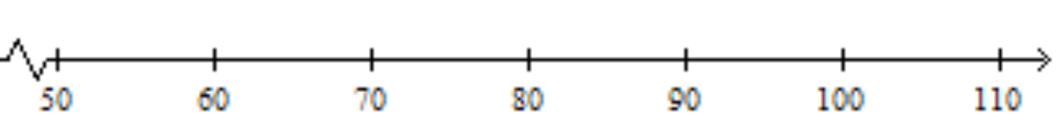
The test scores of two classes are summarized in the following box plots. Which of the following statements are correct?
Test Grades
Class #1
Class #2
True
a) 50% of students in Class #2 scored between 70 to 85%
True
b) 25% of students in Class #1 scored 90% or more
c) The median in class #2 is greater than the median in class #1
False
d) The mean score of students in class #2 is 80%
False
e) The interquartile range of scores in class #1 is 10%
True
f) A student in Class #2 got 45%. That score would be considered an outlier
True

Slide 12
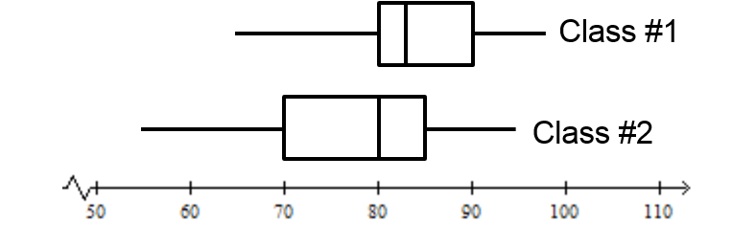
Observations are made with the boxplot of the two classes. What critiques can you make with each statement?
Test Grades
a) Students in Class#1 are better because they have a higher median and 75% of their students are above the median of the other class.
Refrain from using the word “better” b/c these two classes can be assessed with different standards. Instead, use “higher median score” or Q1 &Q3 scores
B) Assuming assessment standards are equal, the instructional strategies in Class#1 is more effective because students have a higher score.
Without indicating that the students were randomly chosen, you can’t make any conclusions. One class could have smarter students.
C) Assuming classes were chosen randomly and assessment standards are equal, we can state that class #1 is stronger if asked to make an observation.
If we are to make any observations, it is best to state only facts and not conclusions. For instance, compare the values of their Q1, Q3, Median, Max, Min, Range, middle 50%.
If we are to make any conclusions make sure it is supported with facts and also be aware of any lurking or confounding variables.

Slide 13
II) Stem and Leaf Plot
Shows the distribution for Quantitative variables
Includes actual numerical values in the graph
Useful for comparing data sets back to back
The last (rightmost) digit becomes the leaf, and is plotted to the right of the vertical bar
The left digits become the stem, which are plotted to the left of the vertical bar
The stems and leaf are listed in order
If there are too many values, remove last digit and make all values in terms of 10 OR
Split the stems: 1st half and 2nd half
© Copyright all rights reserved to Homework depot: www.BCMath.ca

Slide 14
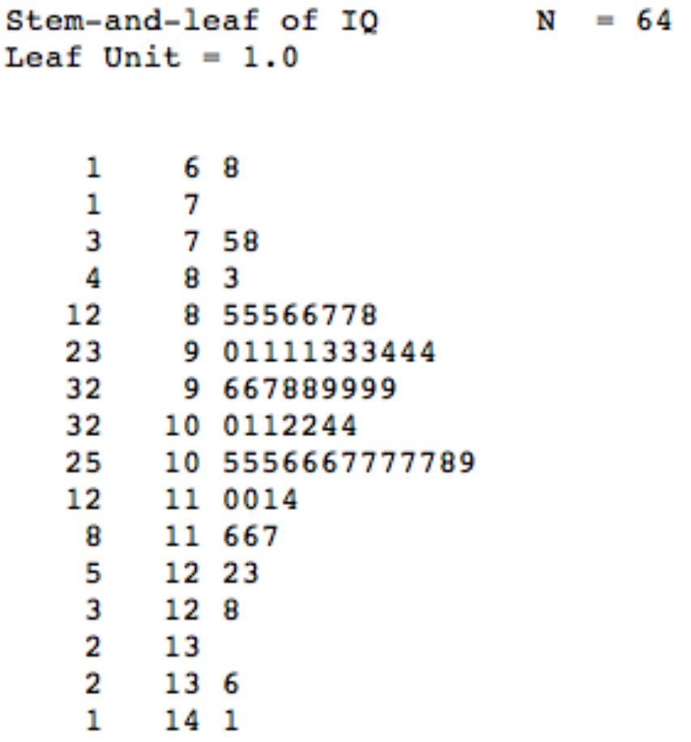
Stem and Leaf Plot:
This is a stem-leaf plot
Things to consider when looking at a stem leaf plot:
What is the median?
What is Q1 and Q3?
This is the cumulative count from both ends of the list
Are there outliers?
What is the shape of the distribution?
Is it symmetrical or skewed?
This column is the stem. It’s the tens digit for data points
These numbers are the leaf. It’s the ones digit for data points

Slide 15
Making a Stemplot
Ex: The following data indicate the age of the audience in a workshop. Draw a stem-leaf plot for the data: i) Describe the distribution:
ii) Which measure of central tendency is best for describing the average age of the audience? Explain
Take the tens digit to form the stem
Q: Describe the distribution
The distribution is relatively symmetrical and is slightly skewed to the right. There are No outliers
The “ONES” digit
is used to fill in the plot
Q: Which measure of central tendency is best for describing the age?
The median would be the best because the distribution is slightly skewed to the right and is less affected by the tail
The smaller digit
on the left and the
bigger on the right
On the left, we would include the cumulative total
© Copyright all rights reserved to Homework depot: www.BCMath.ca

Slide 16
Describing the Distribution
When asked to describe a distribution, these are things we want:
Shape : Q: Is it symmetrical? a bell curve? Or Skewed?
Center: Q: Where is the middle 50%? IQR?
Spread/Range? Find Q1 (25th per), Median, Q3 (75th per), IQR?
Are there Outliers: If yes, justify it, show calculations
Symmetrical vs Skewed (Important)
A graph is symmetrical if the mode is in the middle, equal numbers of either side of the graph
A graph is skewed when you have data points that are either much bigger or smaller than your normal range of values
Property values, salaries...
Symmetrical – mean, median, mode are all equal
Skewed Right tail is on the right (most values are small)
Skewed Left tail is on the left (most values of large)
© Copyright all rights reserved to Homework depot: www.BCMath.ca

Slide 17
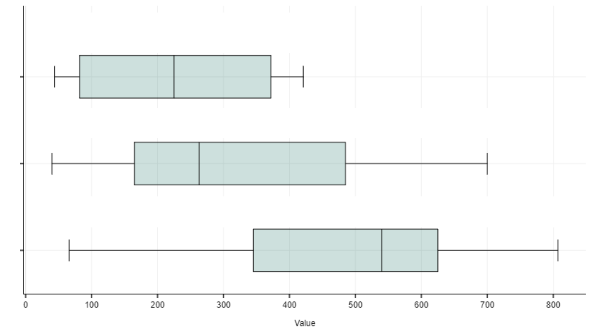
Using BoxPlots to describe Distribution
A symmetrical box plot generally indicates a normal distribution
A longer whisker or box on either side means the distribution is skewed towards one of the sides
Ex: Use each box plot to describe it’s distribution:
A: The first box plot is centered around 230 and is symmetrical. The IQR (middle 50%) is between 90 to 390. The range is from 50 to 440
A
B: The second box plot is centered around 260 and is right skewed. The IQR (middle 50%) is between 180 to 490. The range is from 50 to 700
B
C
C: The second box plot is centered around 540 and is left skewed. The IQR (middle 50%) is between 350 to 610. The range is from 60 to 800

Slide 18
Histograms
Histograms (Quantitate) are NOT Bar Graphs (Categorical)
The x-axis is the quantitative variable (numbers)
Split the range of data into smaller increments so that you have about 6 to 10 boxes
Ie: data is from 45 to 84: 84 - 45= 39 , 39/6 = 3, make each bar increments of 3
If a box is too high, difficult to recognize distribution, make increments smaller
The y-axis can be labelled with
Frequency (count)
Relative Frequency (percentage),
Cumulative -total count for the current and all previous groups
Cumulative Relative Frequency graph (O-Jive)
© Copyright all rights reserved to Homework depot: www.BCMath.ca

Slide 19
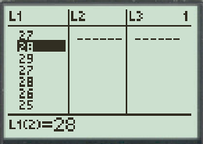
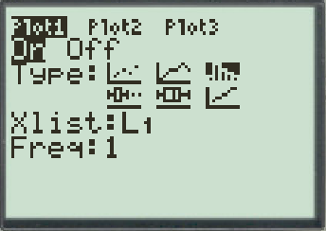
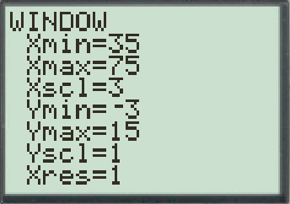
Making a histogram on a ti-83 (p59)
Enter your data in L₁
Press: “Stat” → “1.Edit”
Setup in the histogram
Press: “2nd” “Y=” (Stat Plot)
Press: “ENTER” to go into “Plot1”
Press “On” and select the histogram icon
Press “ENTER”
Setup the window range
“Xmin” & “Xmax” sets the range for the X-axis
“Xscl” sets the width of each bar
“Ymin” & “Ymax” sets the range for the Y-axis
© Copyright all rights reserved to Homework depot: www.BCMath.ca

Slide 20
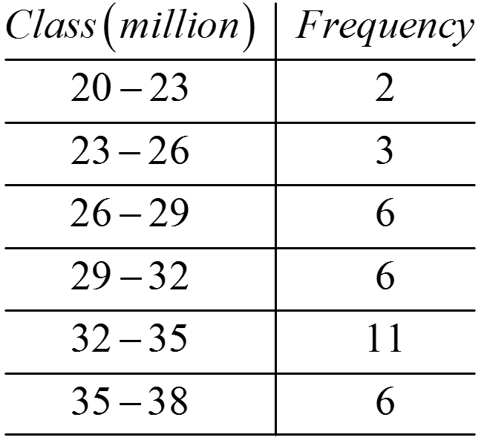
Ex: The following is a list of salaries of 34 football players in the NFL for the class of 2019.
i) Split the data into smaller increments and make an histogram
ii) Create a cumulative frequency graph
iii) Create a relative frequency graph
iv) Create a cumulative relative frequency graph [OJIVE]
v) Describe the distribution of salaries of the 34 football players
(Million of dollars)
20.1, 20.3, 22.4, 23.4, 24.2, 25.6, 26.7, 26.7, 27, 27.3, 28, 28.5,
30, 30.3, 30.8, 31.4, 31.5, 31.9, 32, 32.3, 32.3, 32.4, 33.4, 33.4,
33.9, 33.9, 34, 34, 34.5, 35.1, 35.3, 35.9, 37.2, 37.5, 37.9
The range of data is from 20 to 38
The difference is 18, divide it by 6 → 3

Slide 21
Ex: With the following data, construct a Histogram, Cumulative frequency graph, relative Frequency graph, and a Cumulative Relative Frequency graph(O-JIVE)
Cumulative Frequency Graph
The salaries of 34 NHL players in 2019 are given in the frequency distribution:
Histogram
Cumulative Frequency
Frequency
Salary in Millions
Salary in Millions
© Copyright all rights reserved to Homework depot: www.BCMath.ca

Slide 22
The salaries of 34 NHL players in 2019 are given in the frequency distribution:
Q: How would you describe the distribution?
Cumulative Relative Frequency Graph (%) (O-Jive)
Relative Frequency Graph (%)
1. The distribution is slightly skewed left
2. Indicate where the median is: 31.7
O-Jive
3. Find the IQR by getting both Q1 and Q3
Q1 = 27, Q3 = 34.5, IQR = 7.5
(Middle 50% of this group is earning between 27 to 34.5 million
Relative Frequency %
4. Look for Outliers: 1.5xIQR = 11.25
Q1 – 11.25 = 15.75
Q3 + 11.25 = 45.75 (No Outliers)
Cumulative Relative Frequency
Salary in Millions
Salary in Millions
© Copyright all rights reserved to Homework depot: www.BCMath.ca

Slide 23
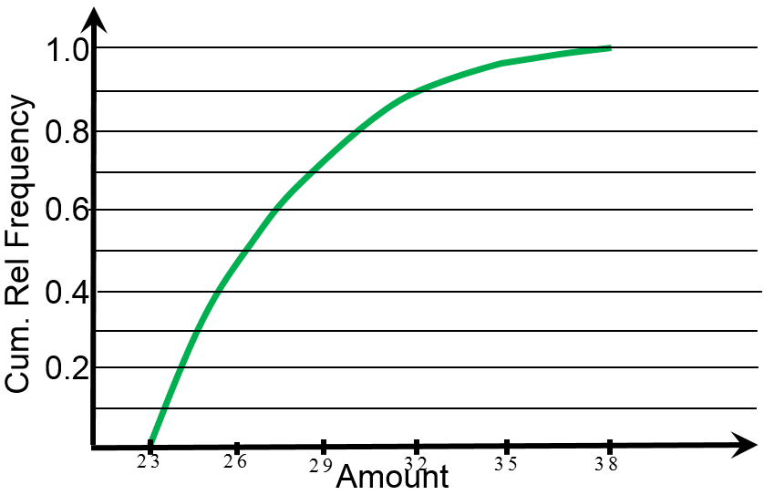
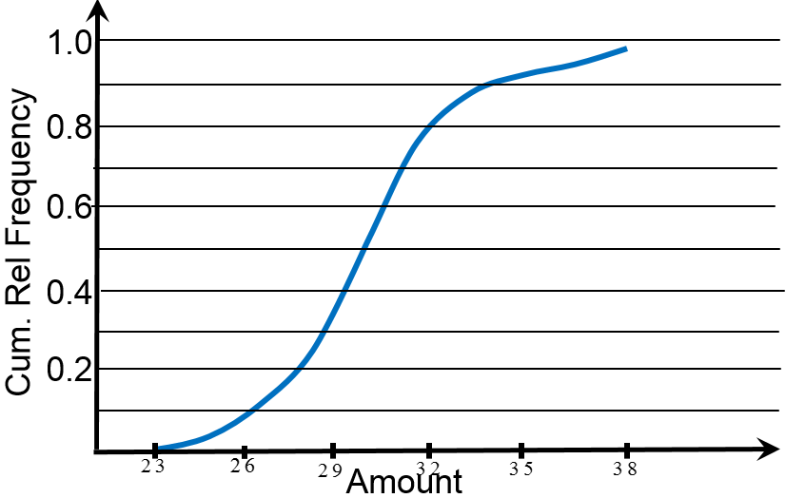
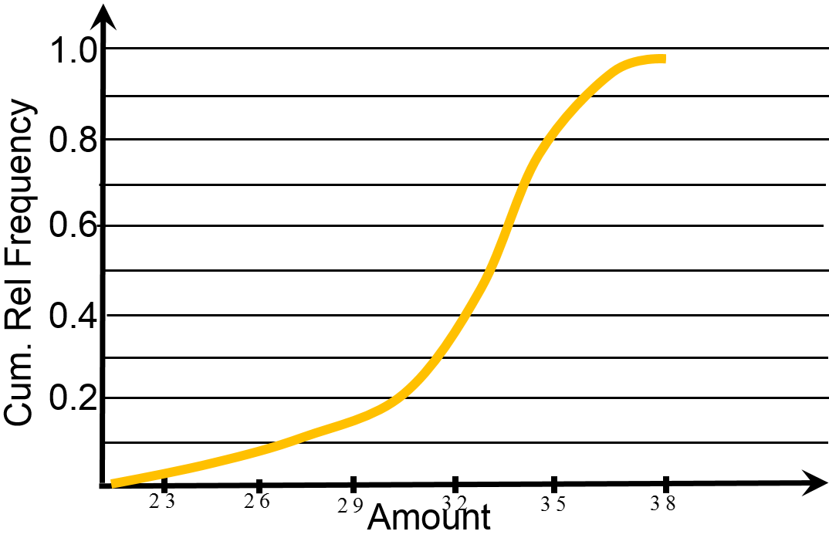
Practice: Given each frequency distribution, correspond it with the correct ogive:
A
B
C
Frequency
Frequency
Frequency
Amount
Amount
Amount
I
II
III

Slide 24
The following Ogive shows the amount shoppers spend at Costco. Use the Ogive to answer the following questions:
a) Estimate the center of this distribution:
Look for the 50th percentile. Approx: $130. So 50% of all shoppers at Costco spend $130 or less
b) What percentile would a shopper that spent $75 fall in?
Around 11% to 12%
Cumulative Relative Frequency
c) What percent of shoppers spent between $100 to $250?
20th percentile to 95th percentile
75% of shoppers spend between $100 to $250
d) What is the 90th percentile? What does it tell us?
The 90th percentile is at around $230.
So 90% of shoppers at Costco spend $230 or less
Amount Spent ($)

Slide 25
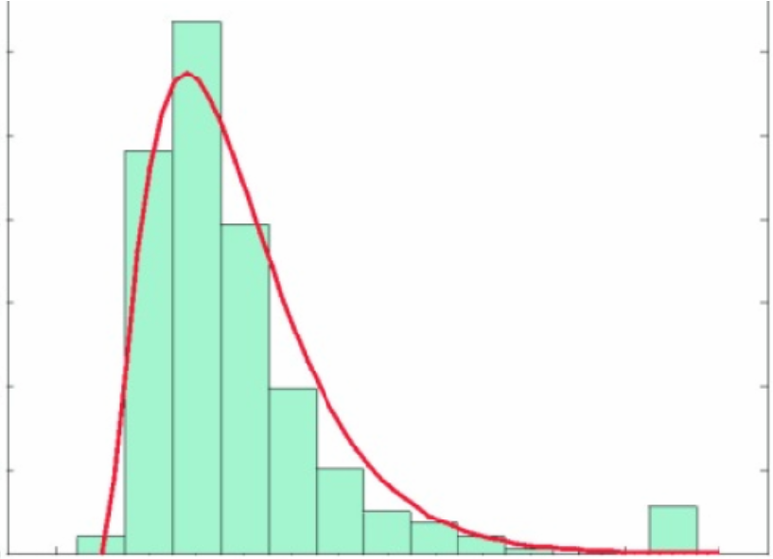
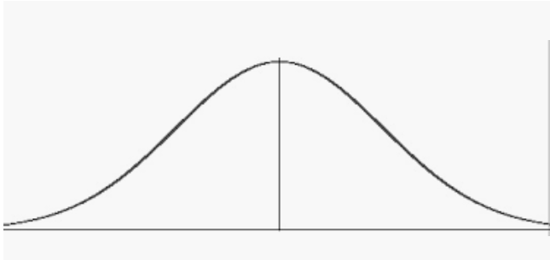
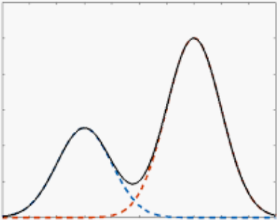
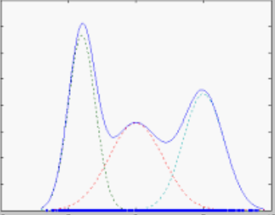
Shapes of Distribution:
Sometimes we simplify a histogram using a distribution graph as shown below
A peak on the distribution graph means that it’s a mode, there are many data points for that range
Unimodal – one major
peak, doesn’t have to be symmetrical
Bimodal – two major
peaks
Multimodal – two or more major peaks
Symmetrical – mode will be center of graph (median)

Slide 26
The following BOX plots show the distribution of scores between students that do their HW and students who don’t. Use the graph to answer the following questions:
Don’t DO HW
Does HW
Q:How would you describe the distributions of scores for students do their HW vs students that don’t? Provide evidences
Students who don’t do their HW have a median score of 60%, with an IQR from 48% to 68%. The distribution is skewed right, with two outliers in the 90s.25% of this group is less than 48%. There is great variability in the scores of students that don’t do their HW
Students that do their HW have a median score of 68%, with an IQR from 60% to 79%. The distribution is slightly symmetrical, but is skewed to the right with an outlier in the high 90’s. 25% of scores is between 50% to 60%. There is less variability in the scores of students that do their HW.

Slide 27
Homework:
Pp65 Q1.15, 1.17, 1.25

